Slide 1
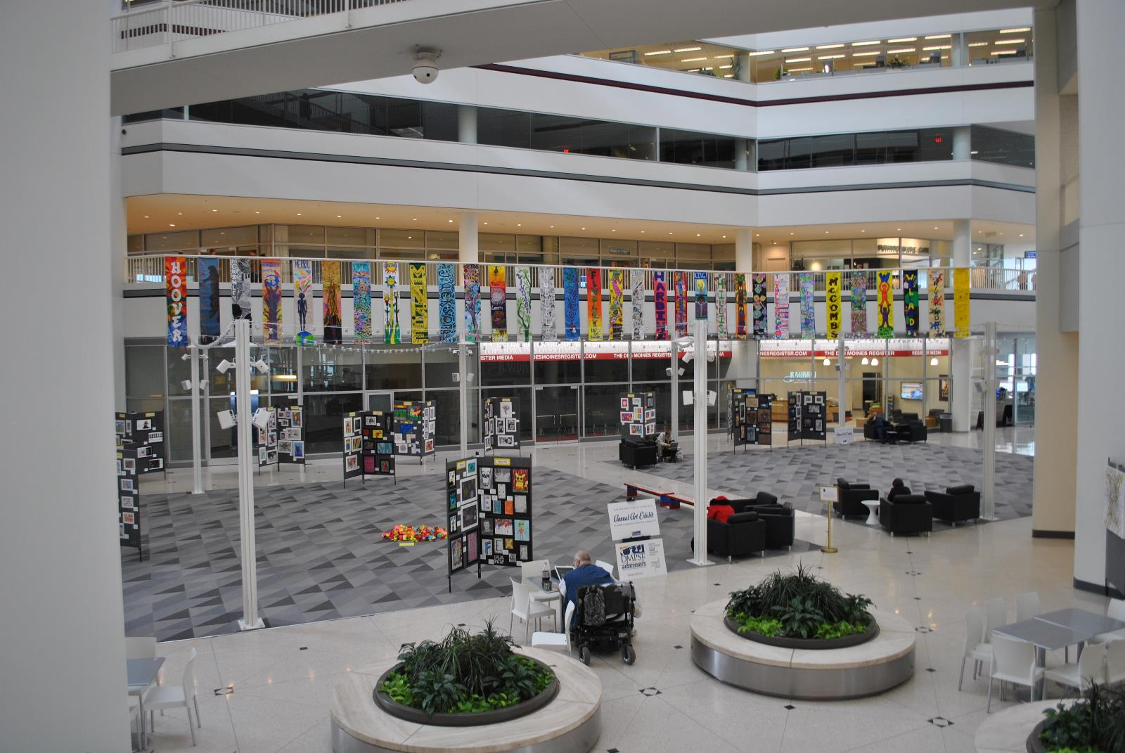
Brubaker Elementary
Lisa Rasmussen & Heather Frank
Art Educators
Kyleigh Thompson 5th Grade
Diane Ziaty 5th Grade
Cora Knoop 3rd Grade
Kevin Sando 3rd Grade
Lauren Inman 5th Grade

Slide 2
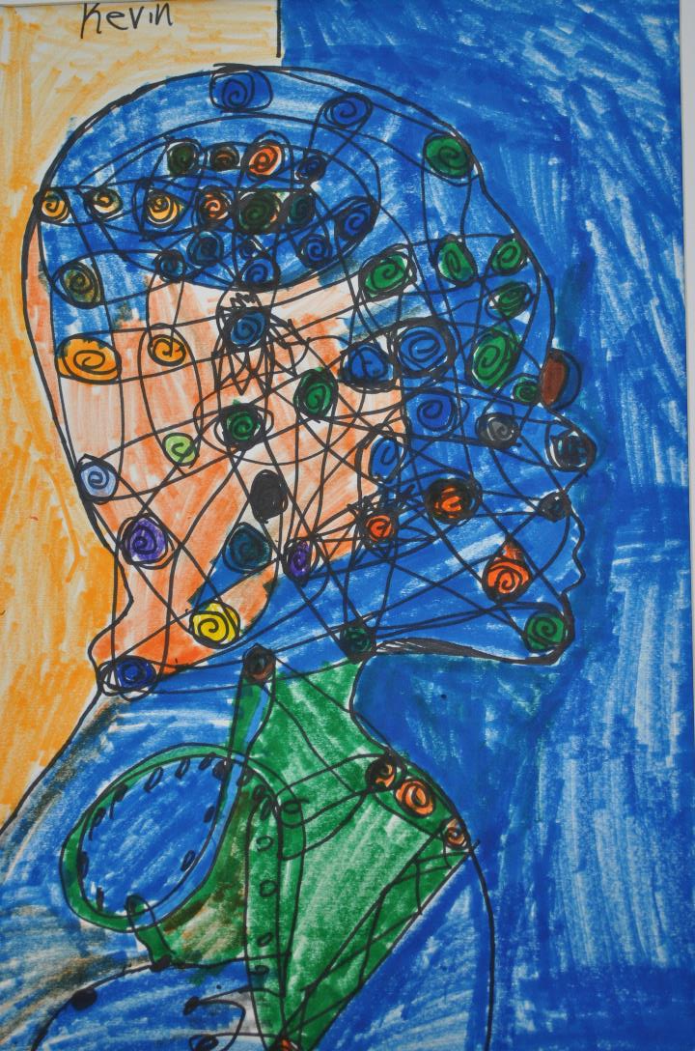
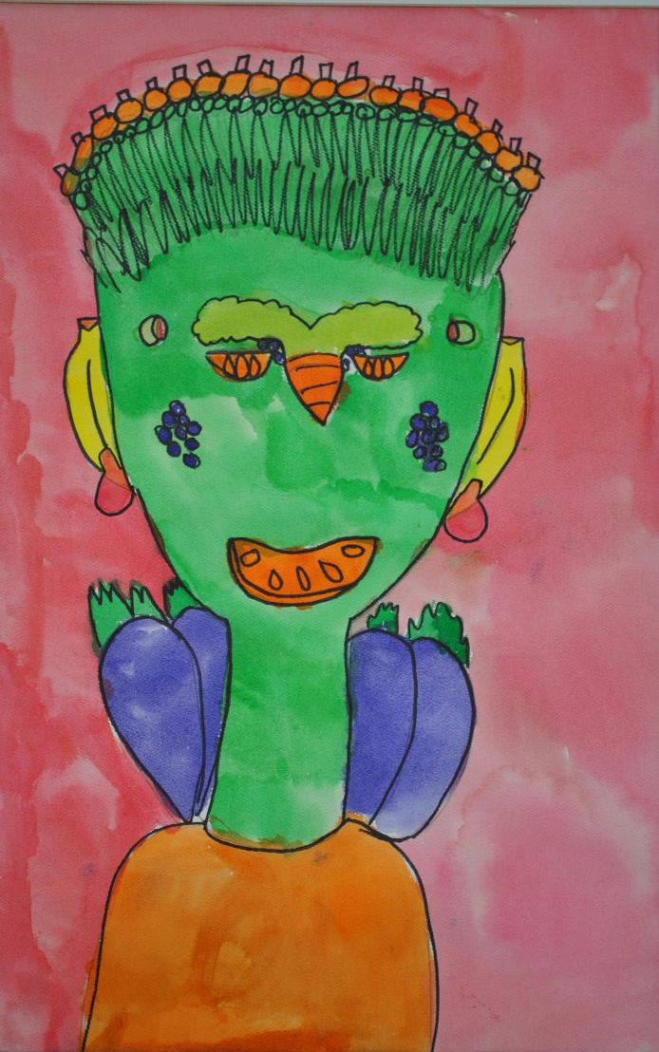

Slide 3
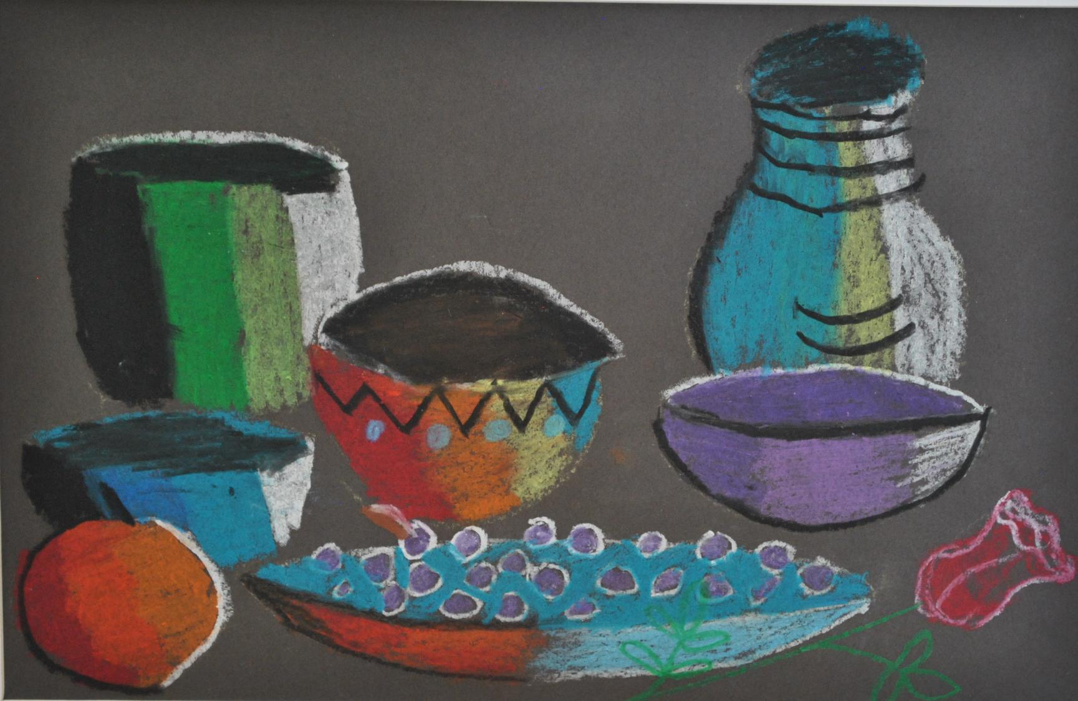

Slide 4
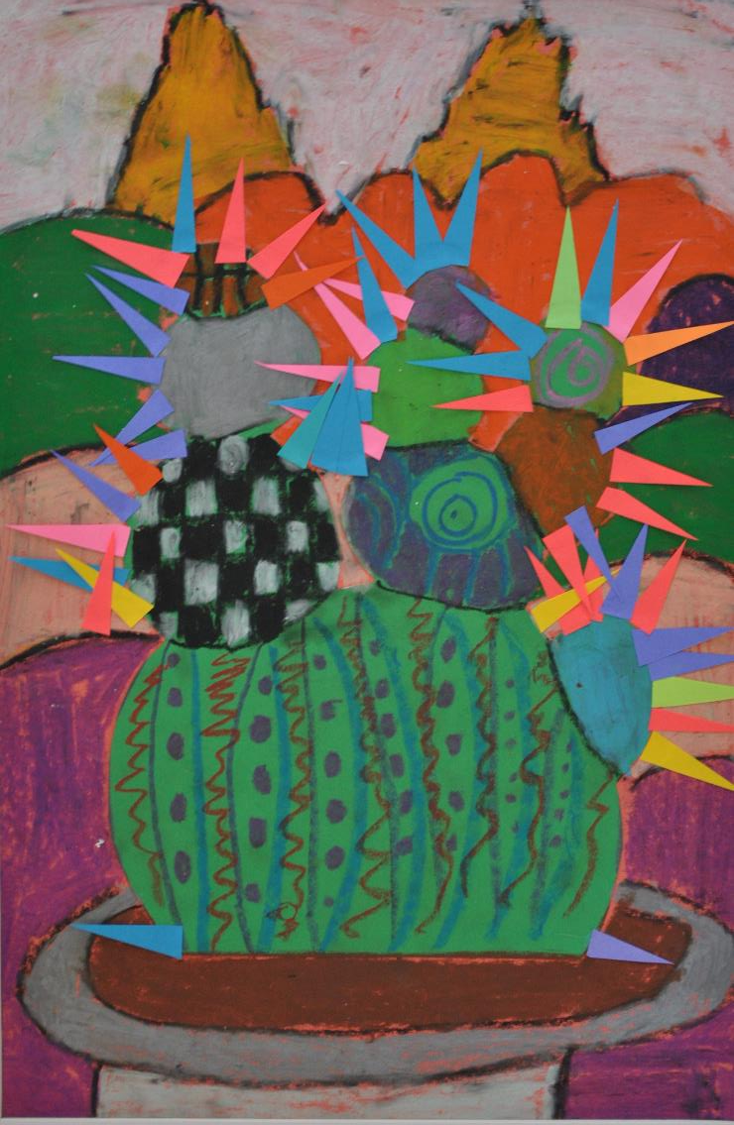
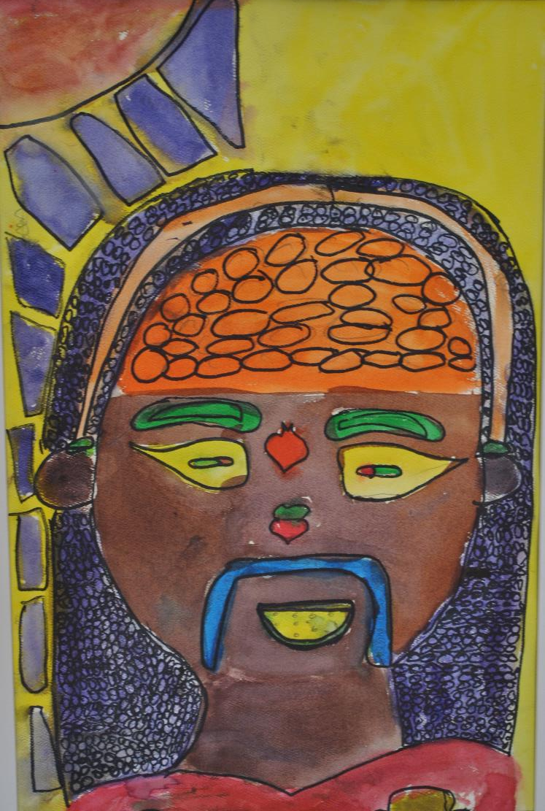

Slide 5
Capitol View Elementary
Kris Morine Schmidt
Art Educator
Allison Sigaran 5th Grade
Nathan Reyes 5th Grade
Trovary Cavil 5th Grade
Nayeli Fierro-Mendez 5th Grade
Nathan Reyes 5th Grade
Trovary Cavil 5th Grade
Danny Doan 2nd Grade

Slide 6
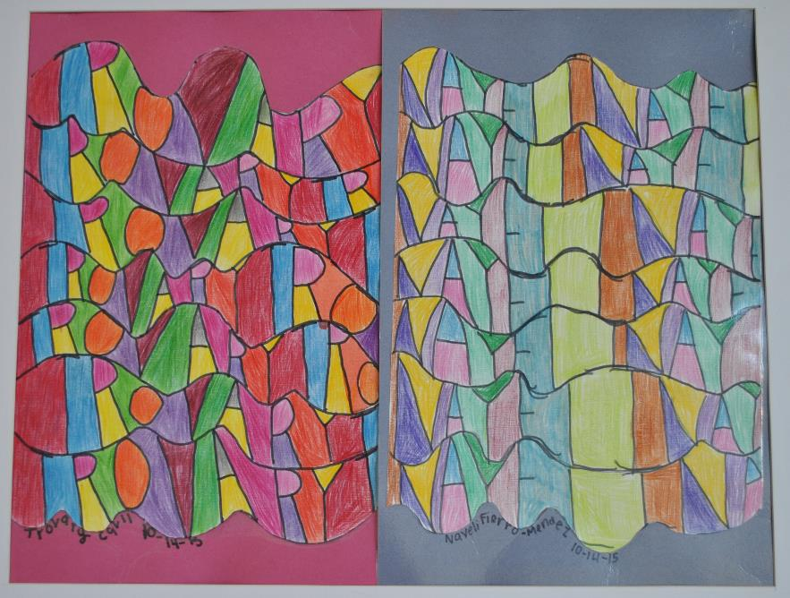
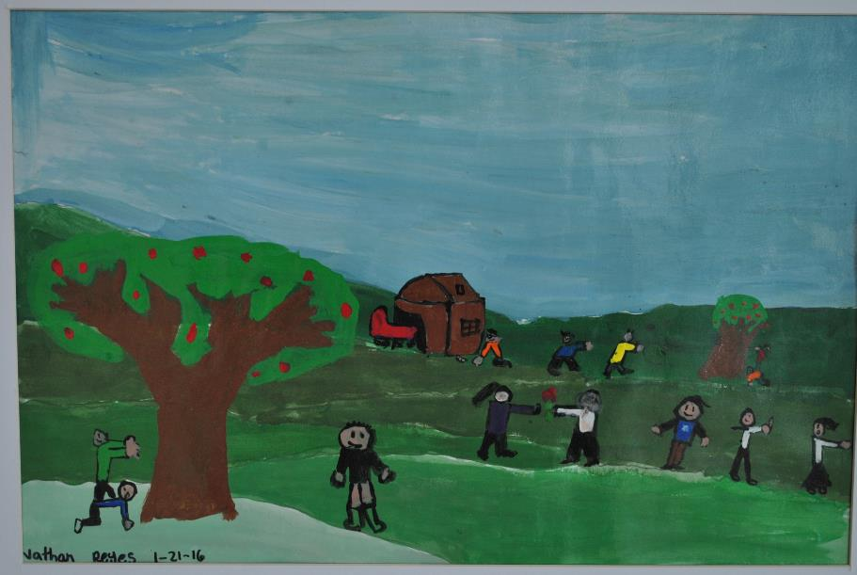

Slide 7
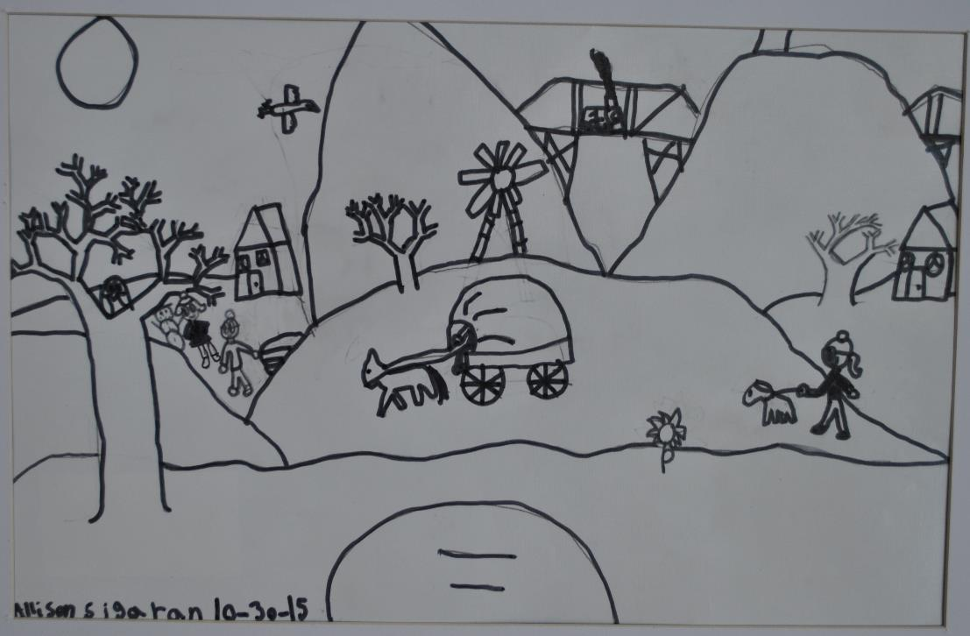
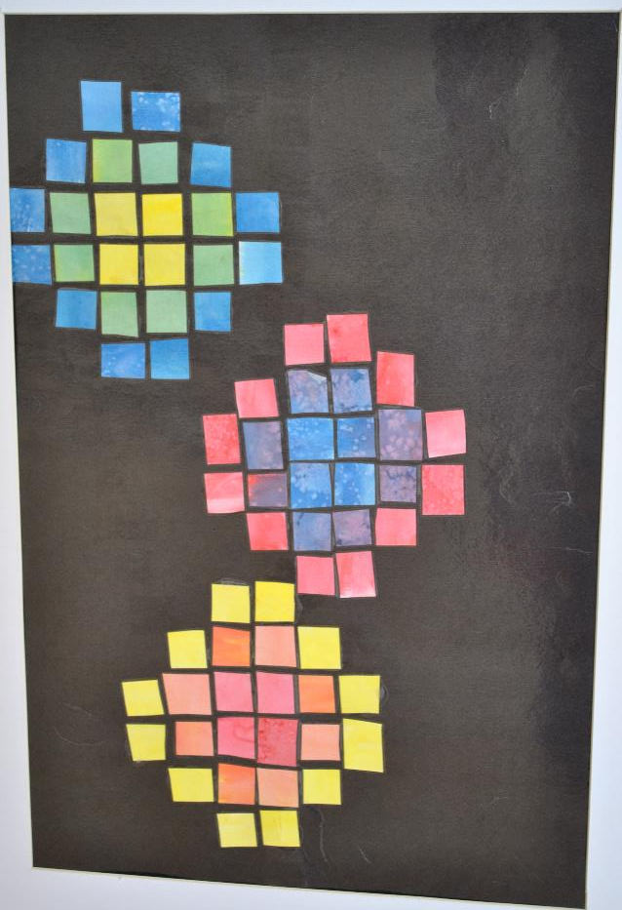

Slide 8
Carver Elementary
Jordan Josephsen
Art Educator
Josue Ortiz-Barillas 5th Grade
Jose Cruz de Jesus 5th Grade
Suria Xayavongchanh 3rd Grade
Ava Saengaroun 3rd Grade
Karma Bell 4th Grade
Austin Hindman Kindergarten
Isis Brown 4th Grade

Slide 9
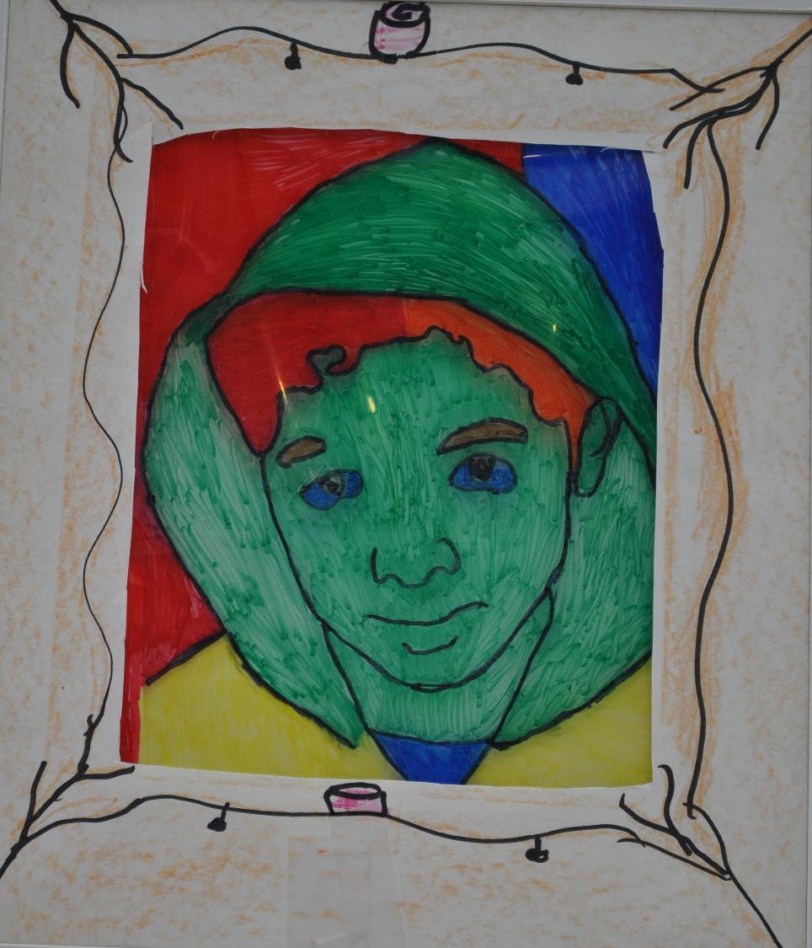
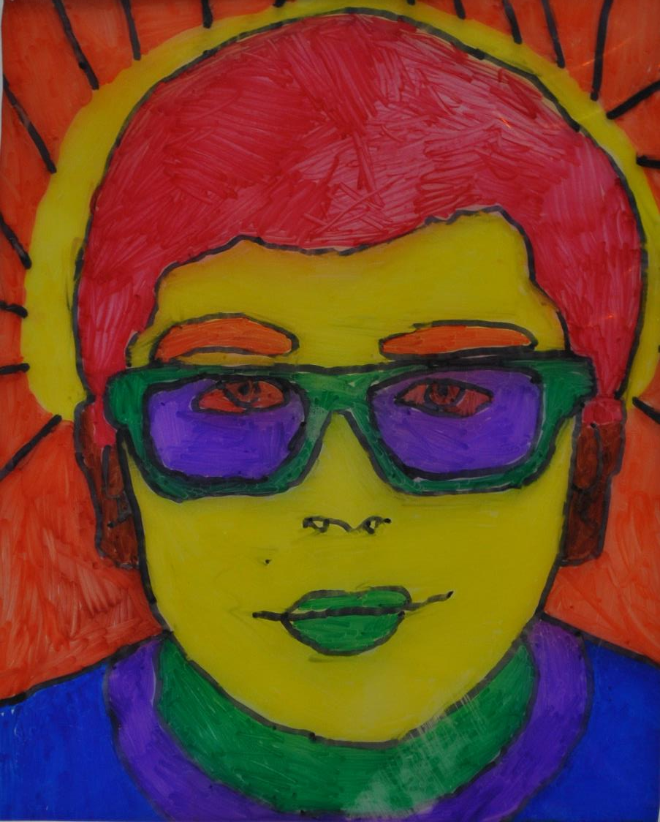

Slide 10
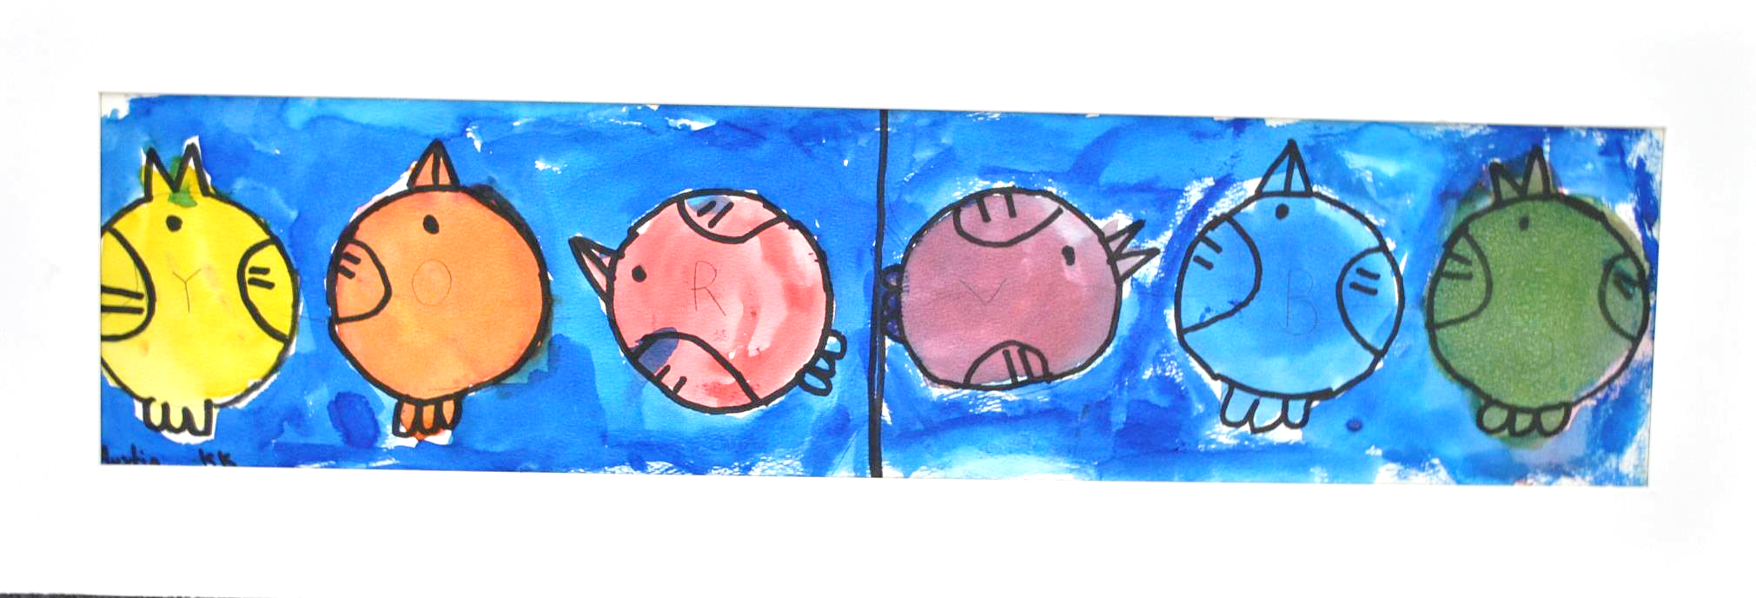

Slide 11
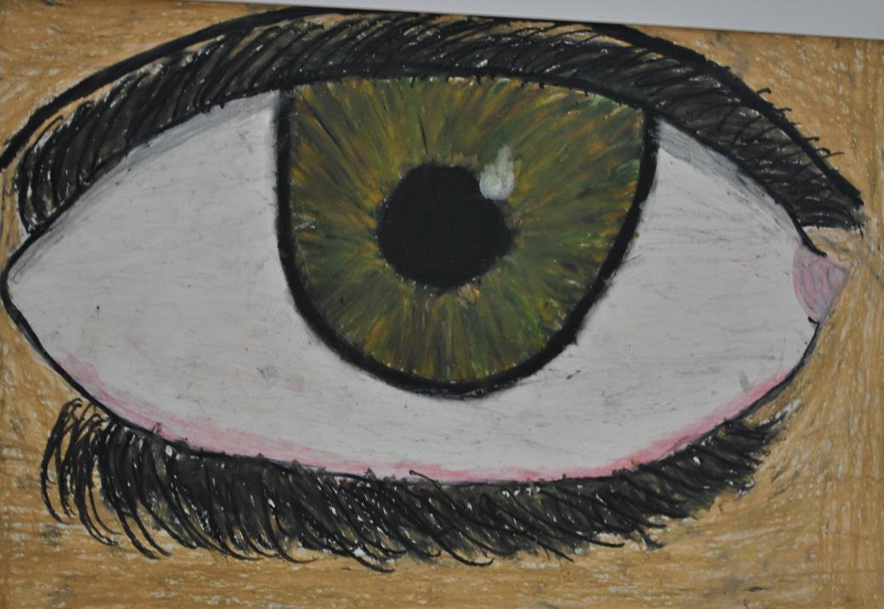
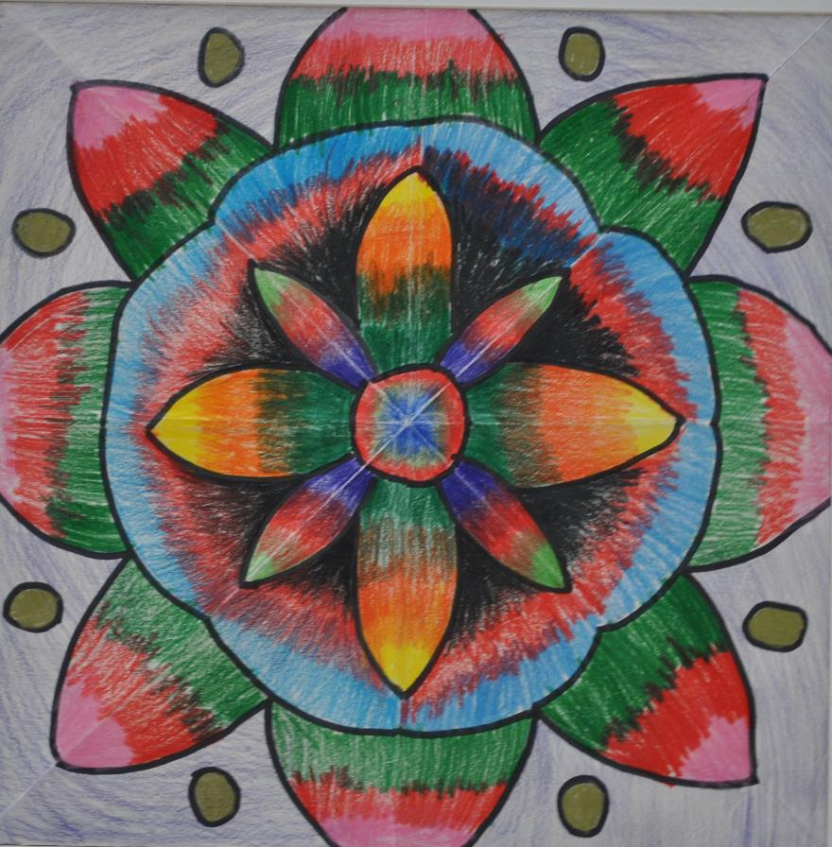

Slide 12
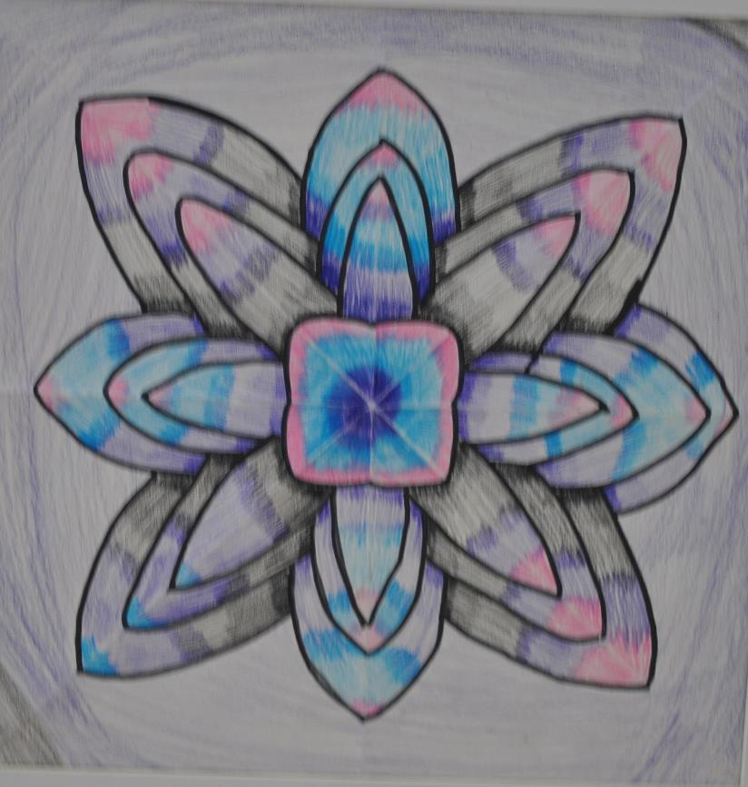
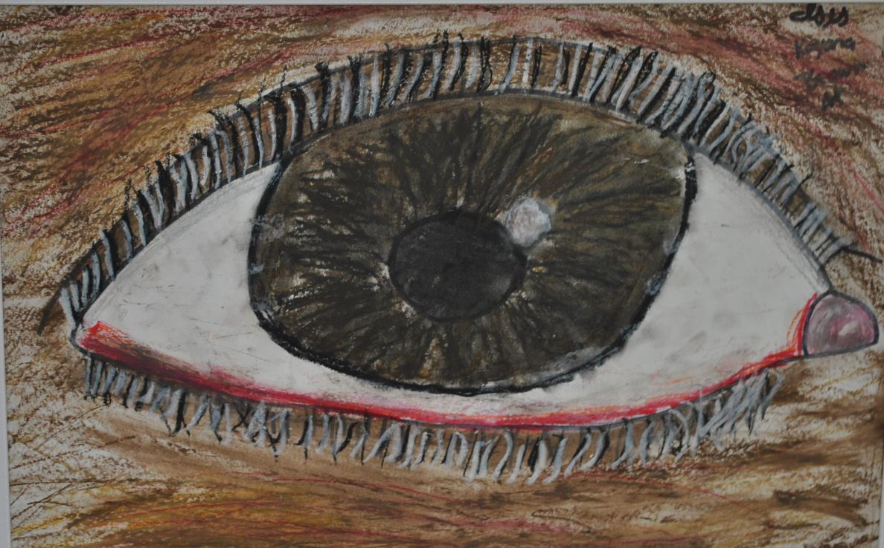

Slide 13
Cattell Elementary
Megan Luna
Art Educator
Montaea Morrison 5th Grade
Asher Brooks 5th Grade
Kyler Petithory 4th Grade
Carlee Langford 4th Grade
Ana Sanchez-Arizmendi 2nd Grade

Slide 14
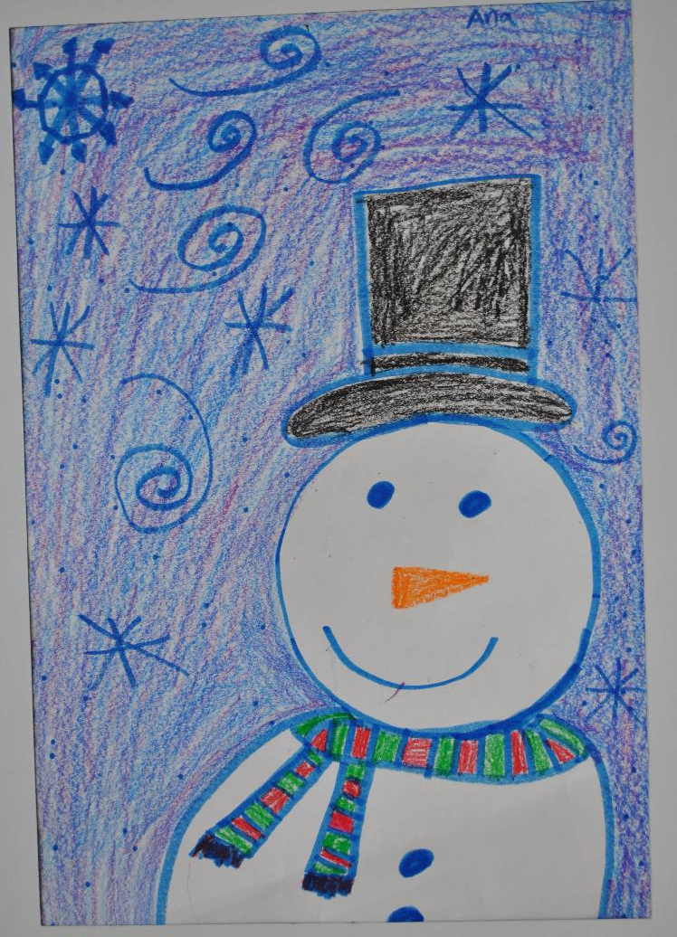
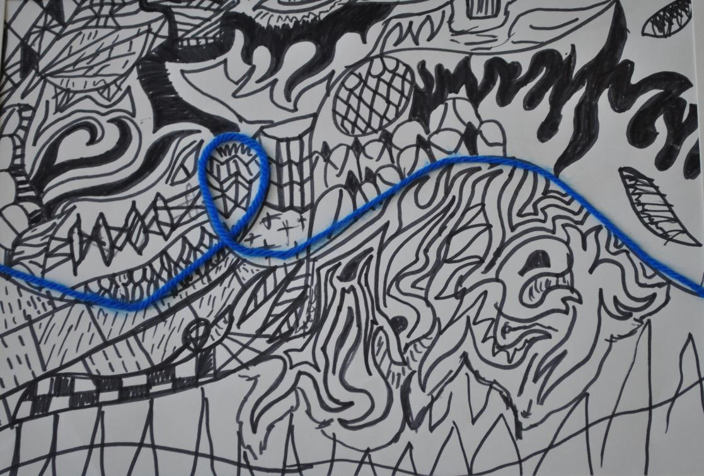

Slide 15
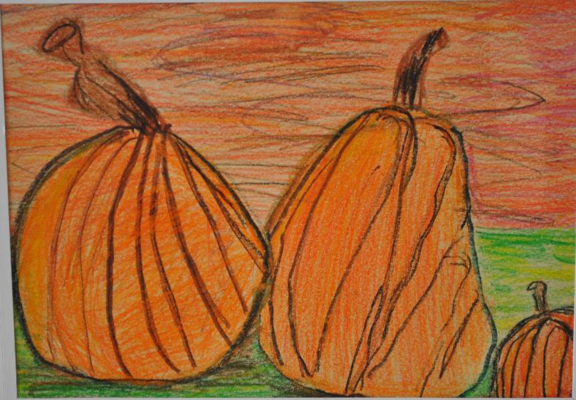
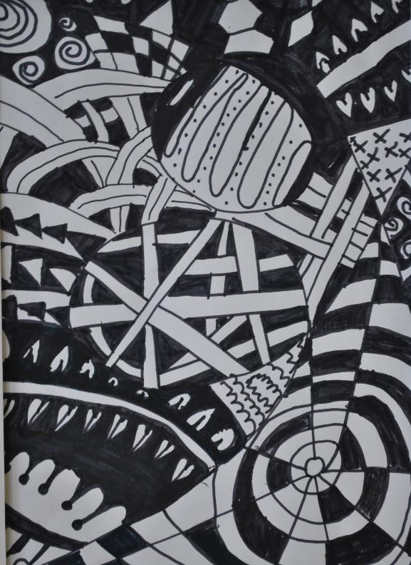
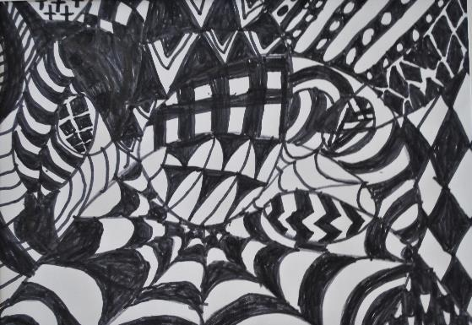

Slide 16
Cowles Montessori School
Kara Dare
Art Educator
Sarah Galluzzo 6th Grade
Maia Clark 5th Grade
Isabella Wagler 2nd Grade
Piper Arganbright 3rd Grade
Carter Ballard 5th Grade
Tay Ohr-Rottler 2nd Grade
Gavin Walker 3rd Grade
Sreehith Baruri 3rd Grade
Vivian Perez Kindergarten
Jack Hearne 5th Grade

Slide 17
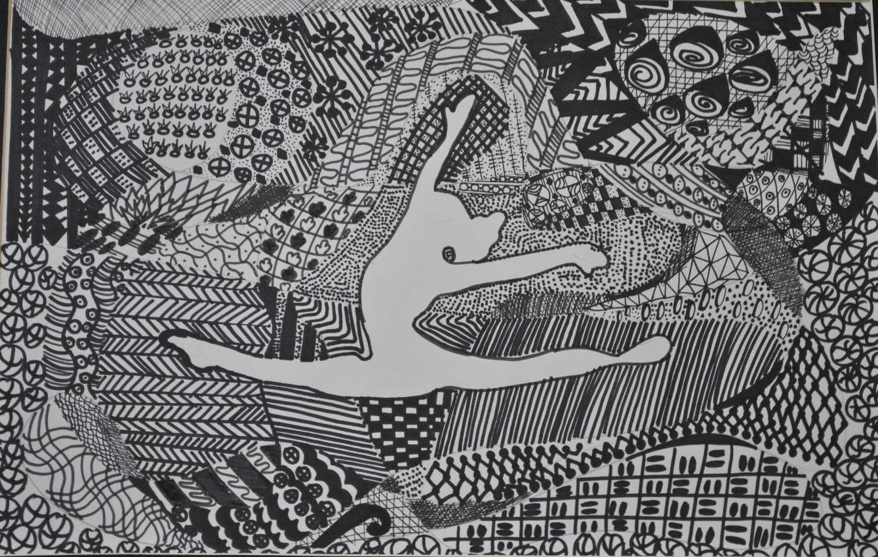

Slide 18
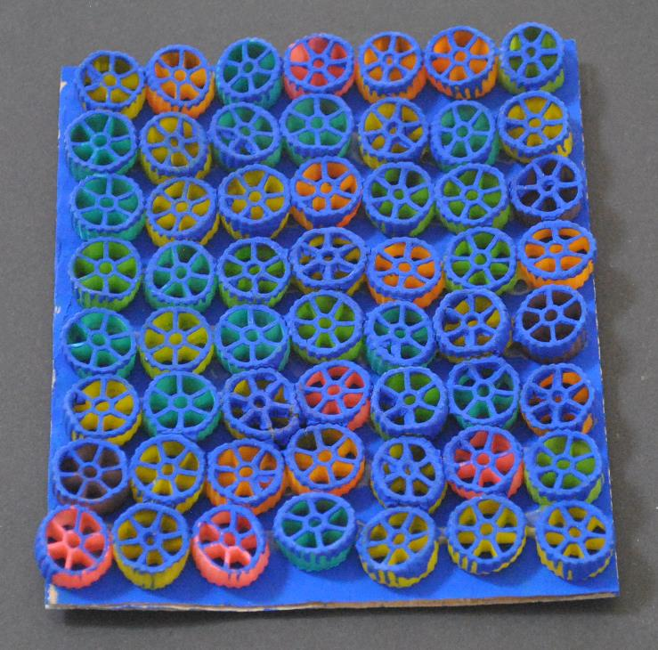
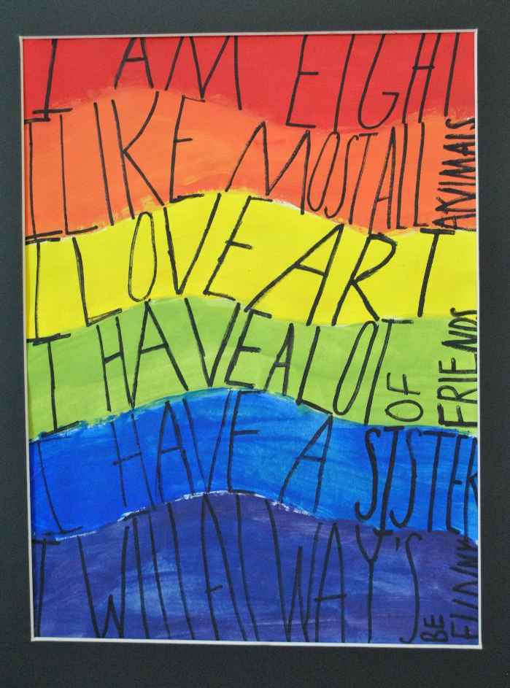

Slide 19
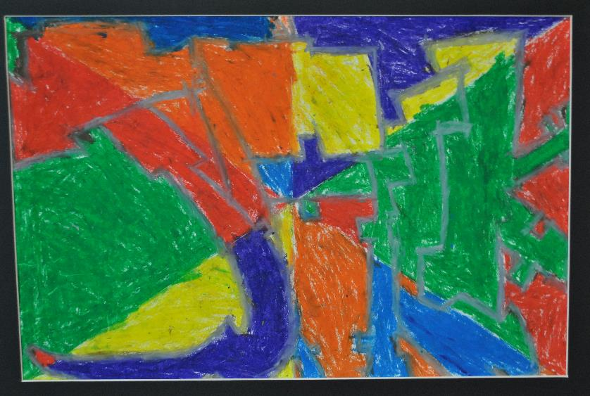
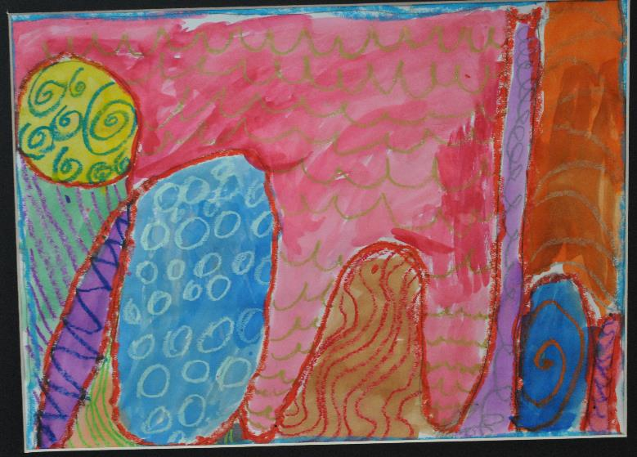

Slide 20
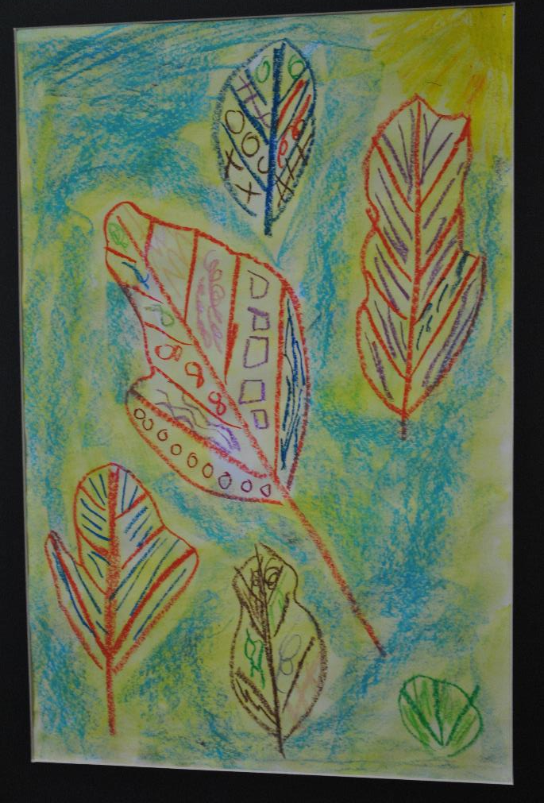
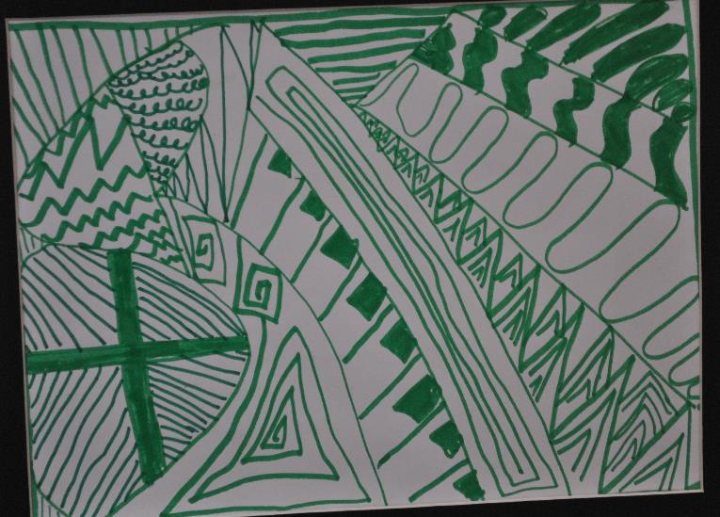

Slide 21
Downtown School
Otto Jones 1st Grade
Rosa Obanya 5th Grade
Alonzo Spencer 5th Grade
Olivia Schall 2nd Grade
Parker O'Neall 3rd Grade
Henry Trettin 2nd Grade
Lilly Camacho Kindergarten
Wyatt Carlson 4th Grade
Delaney Clark 5th Grade
Macy Severs 5th Grade
Maya Lint 5th Grade

Slide 22
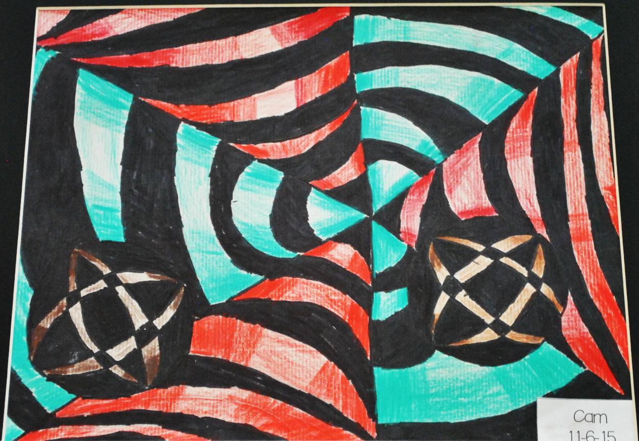

Slide 23
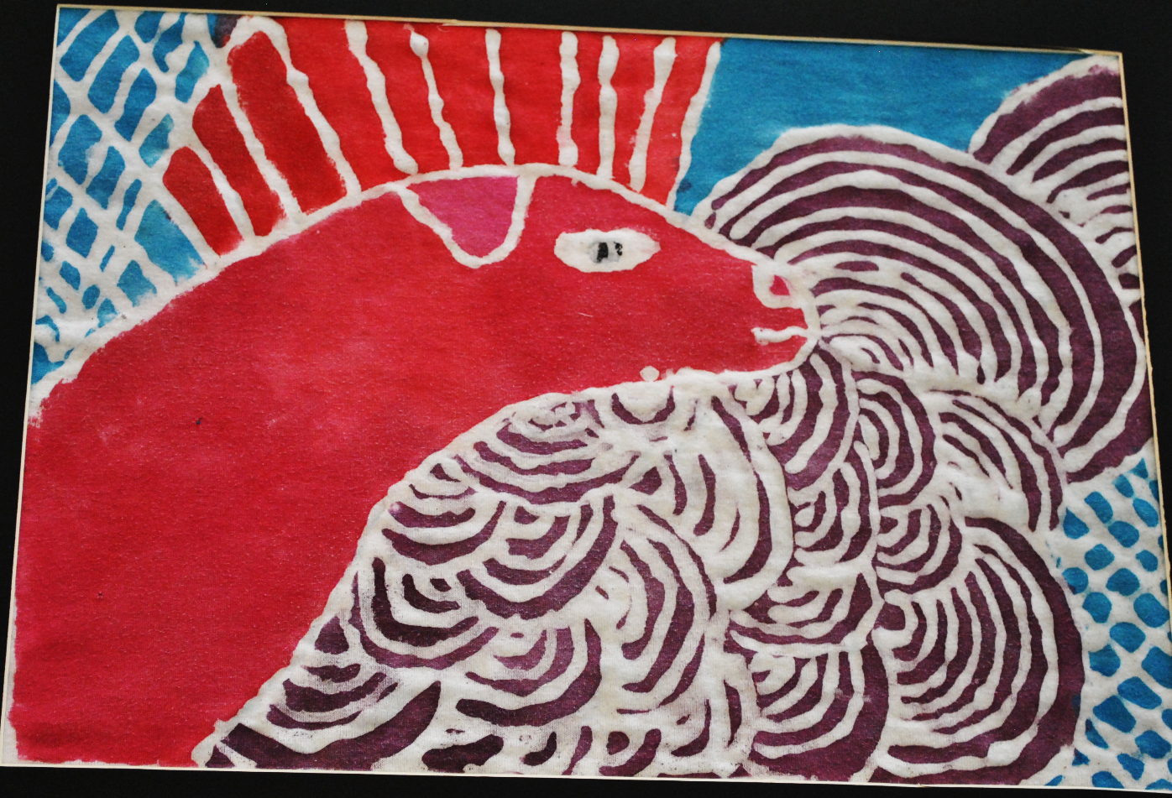

Slide 24
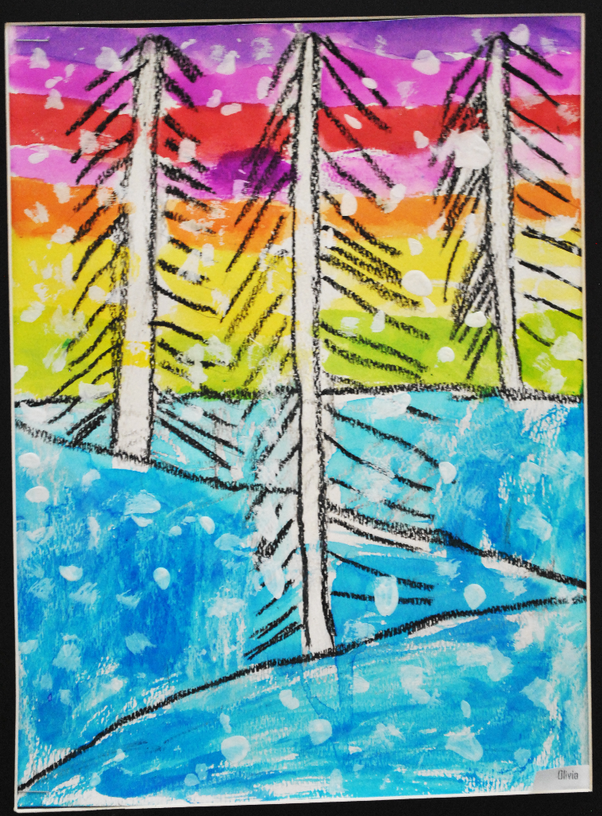

Slide 25
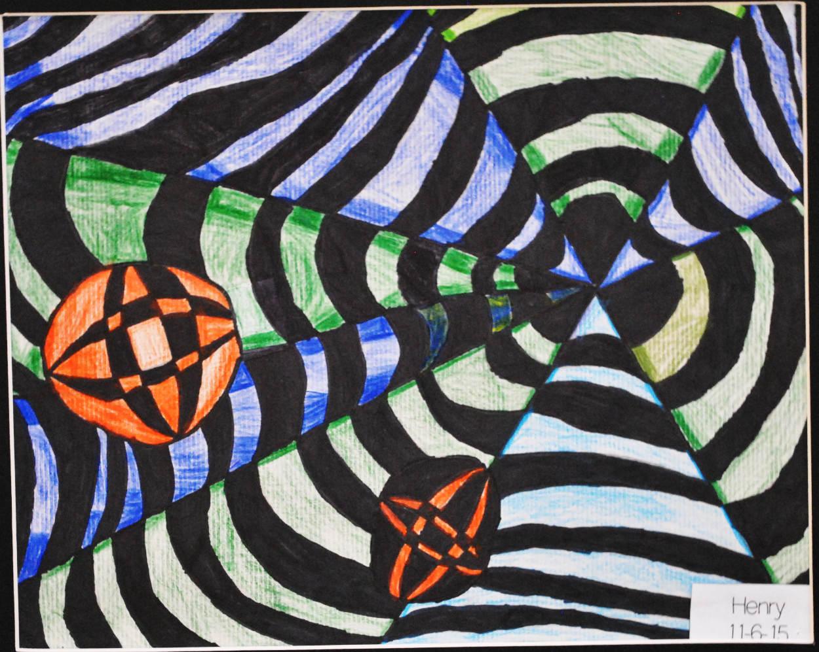

Slide 26
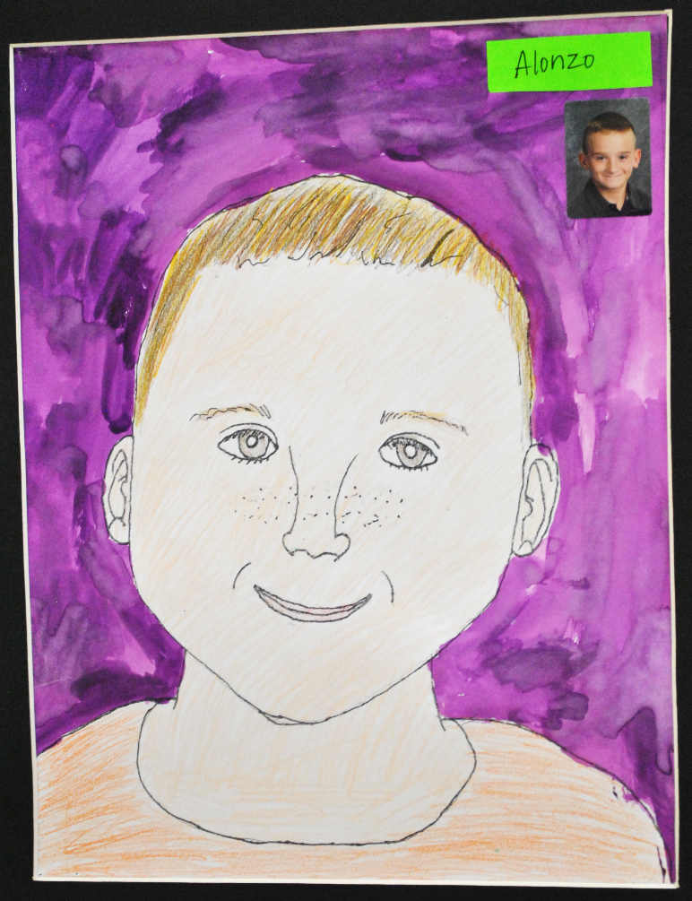

Slide 27
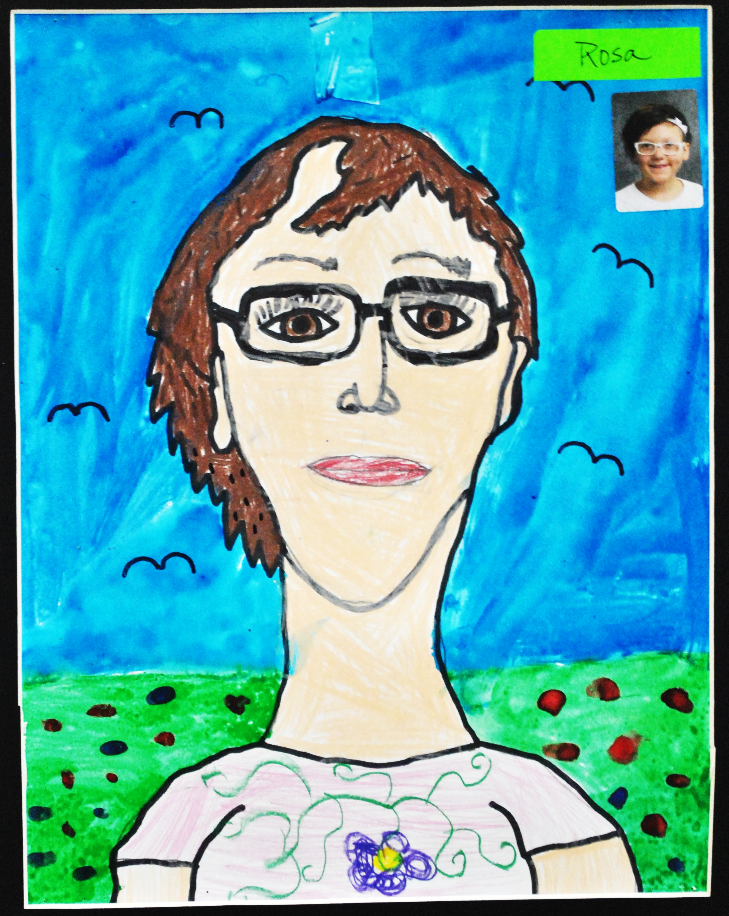

Slide 28
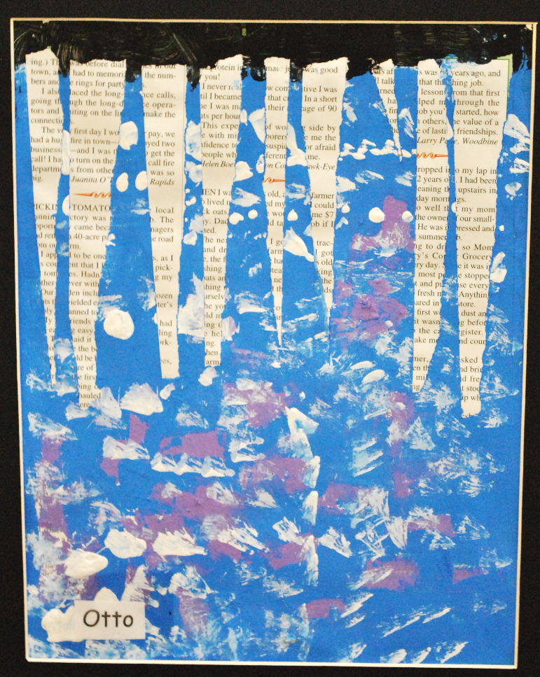
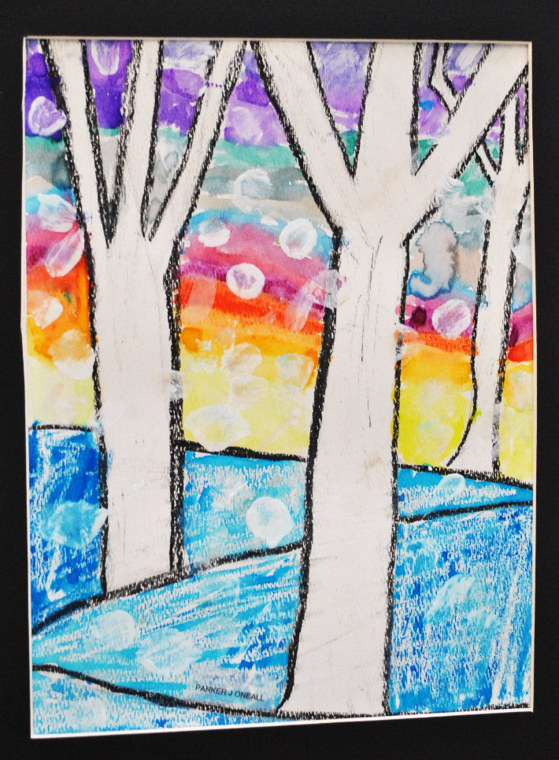

Slide 29
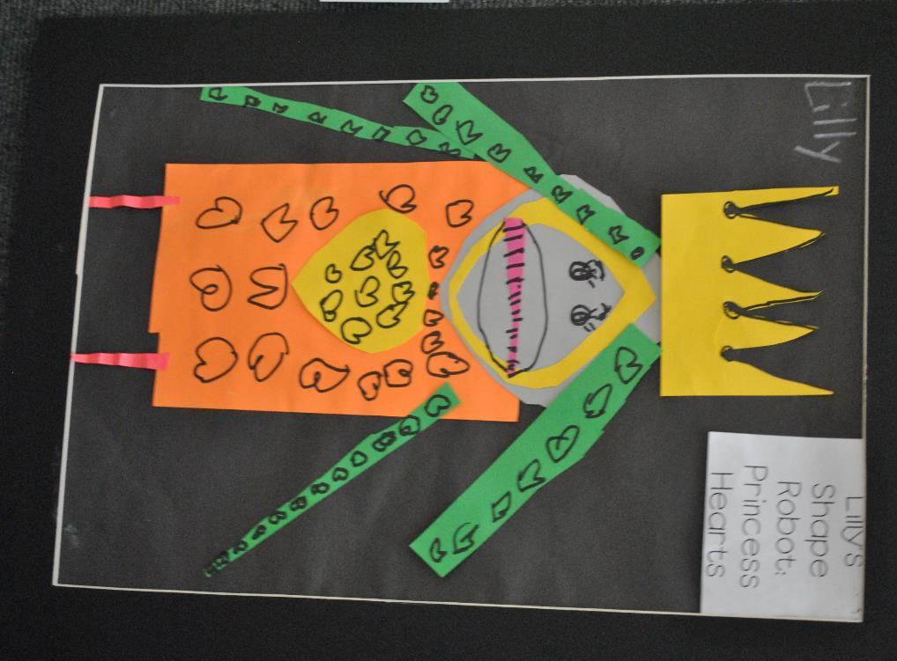

Slide 30
Edmunds Elementary
David Borzo
Art Educator
Renay Whitfield Kindergarten
Pum Dai 1st Grade
Ashay Mneur 5th Grade
Sobeth Koki 5th Grade
Savanah Vathananonh 5th Grade
Marlayna Schmidt 5th Grade
Kadija Marah 3rd Grade

Slide 31
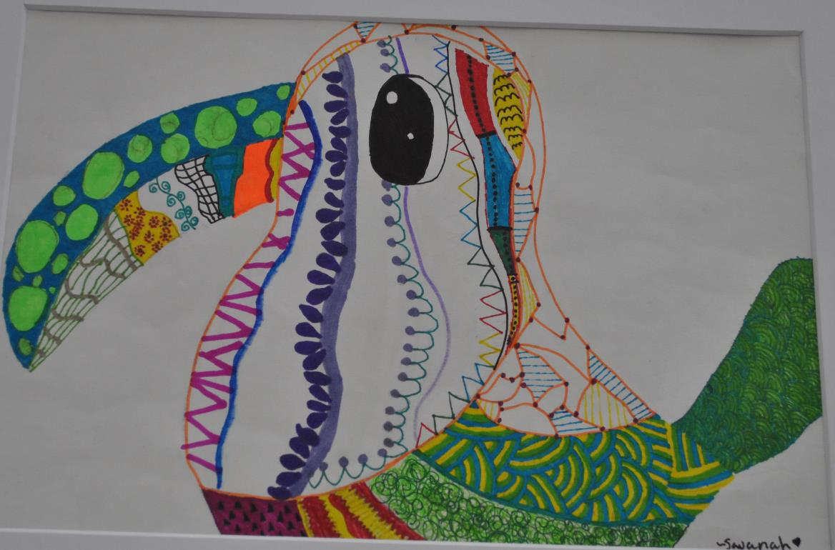
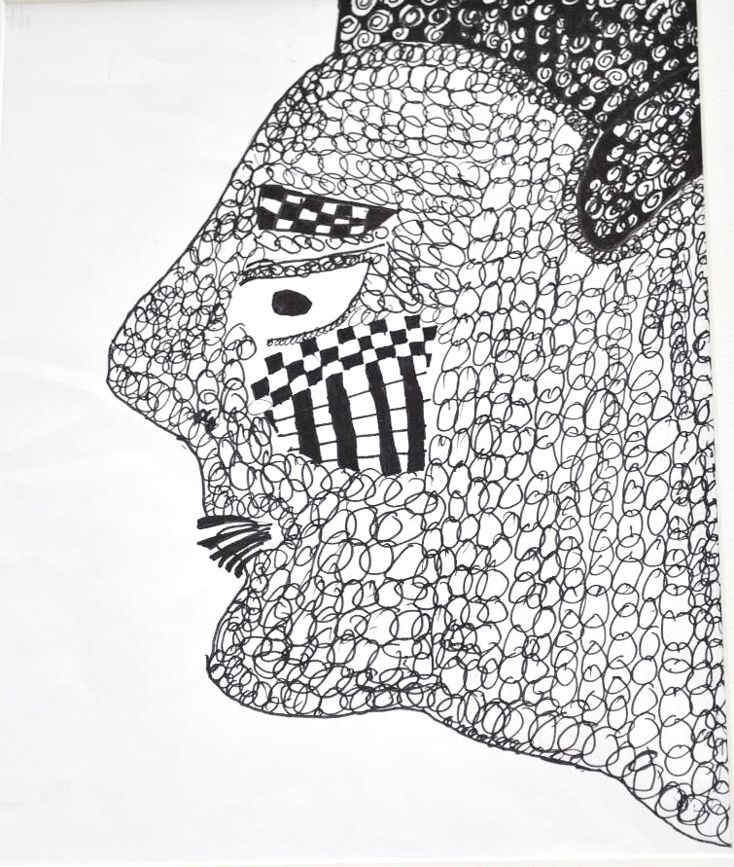

Slide 32
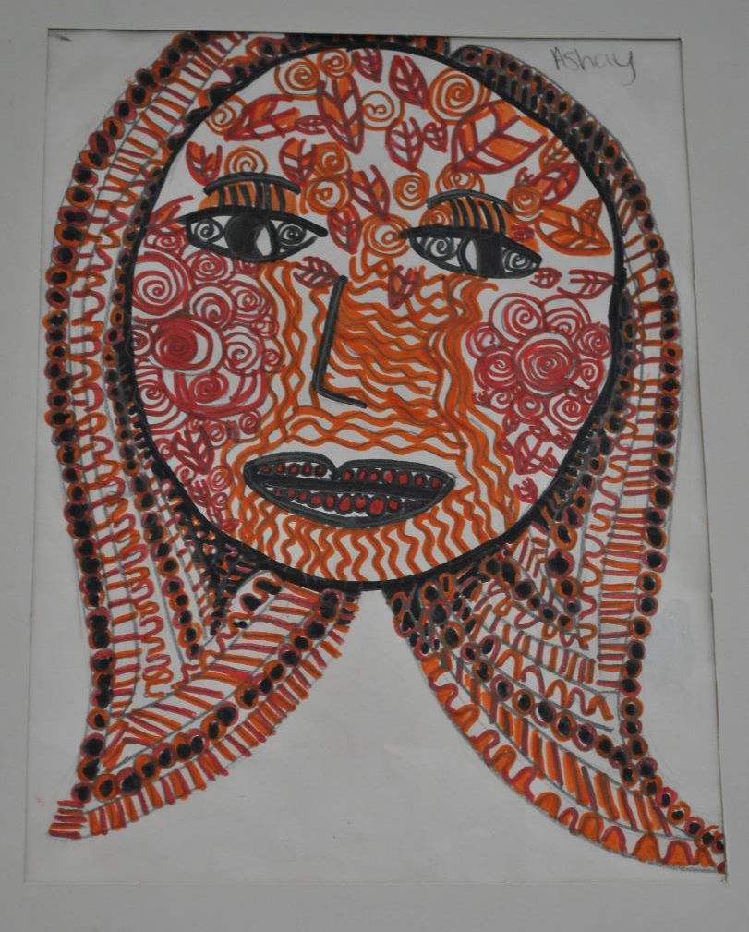
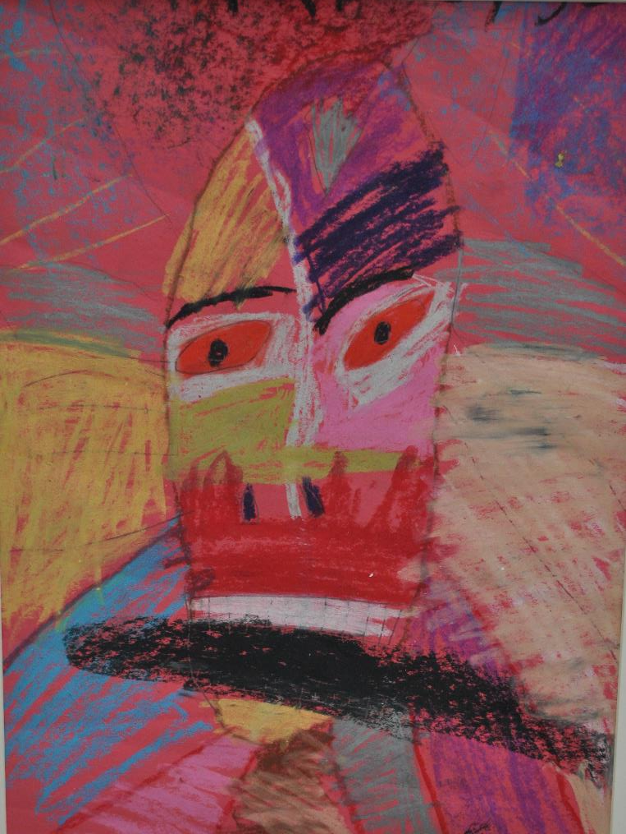

Slide 33
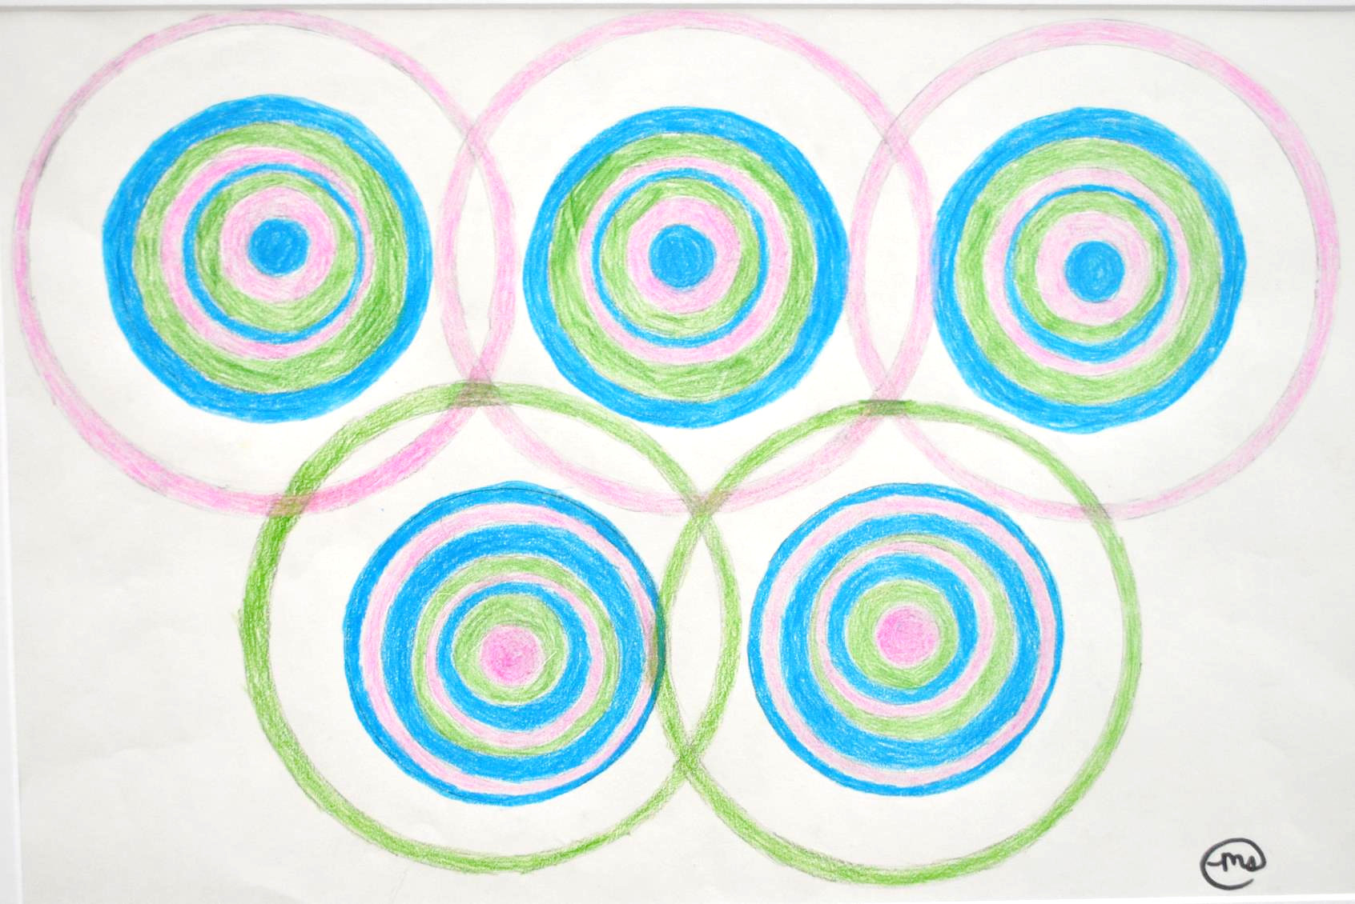

Slide 34
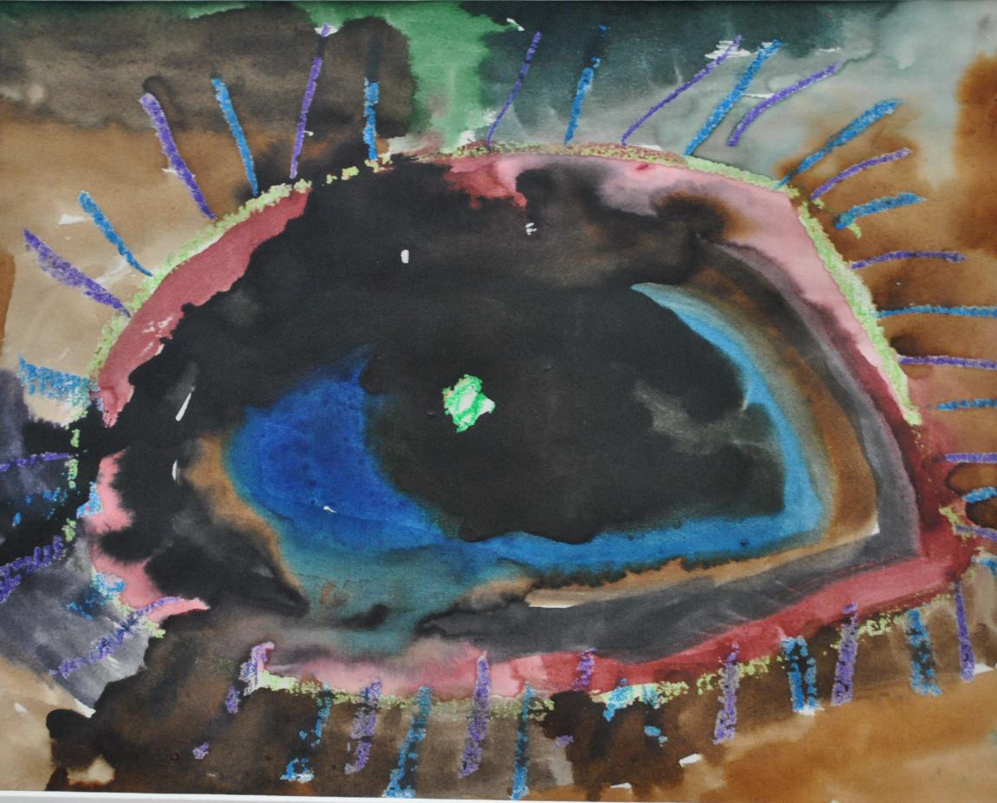
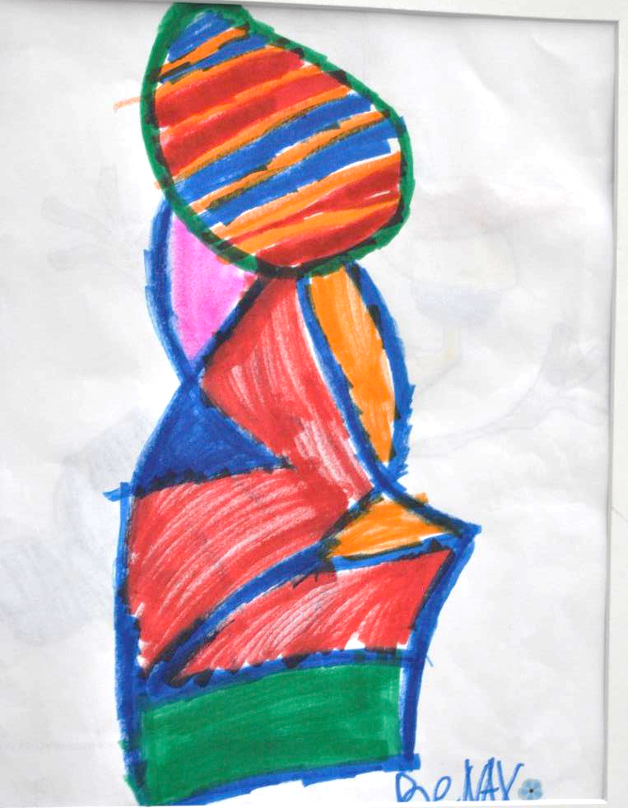

Slide 35
Findley Elementary
Lisa Hesse
Art Educator
Janet Dao 3rd Grade
Mario Simmons 3rd Grade
Fernando Rios-Contreras 3rd Grade
Jeremy Bash 3rd Grade
Ana Marie Martinez 2nd Grade
Kaylin Madewell 2nd Grade
Gary Ellis 4th Grade
Alexia Sanachit 4th Grade
Kaleb Powers 5th Grade

Slide 36
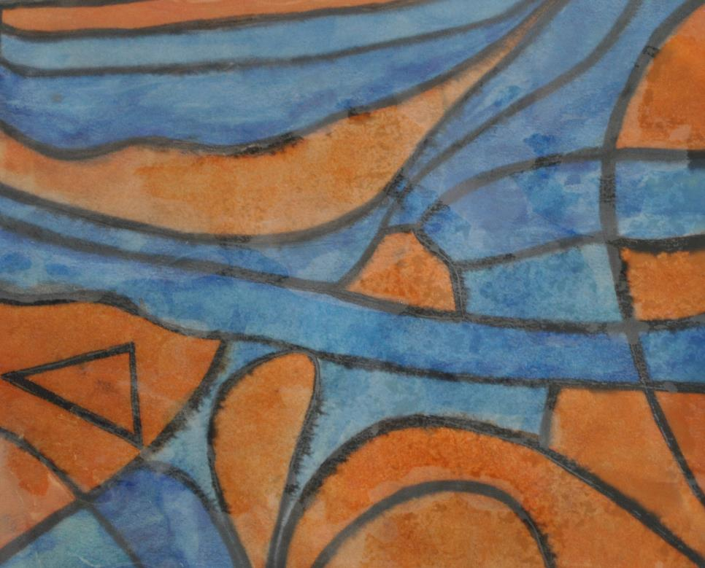
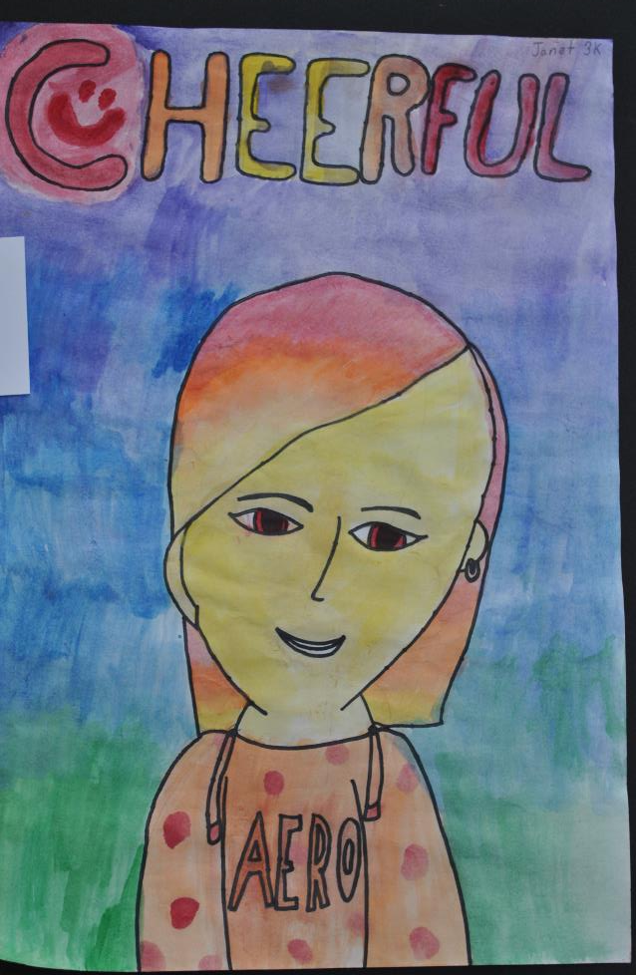

Slide 37
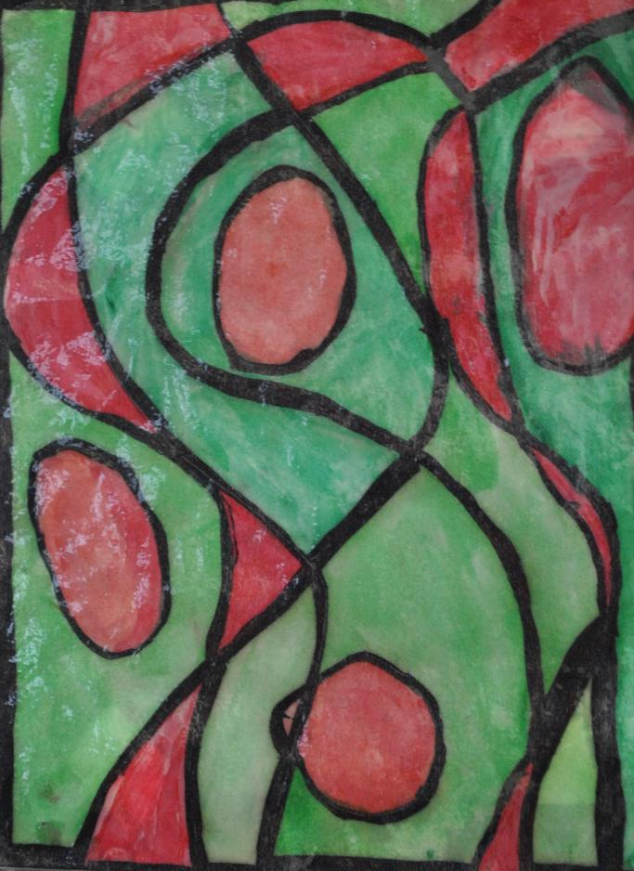
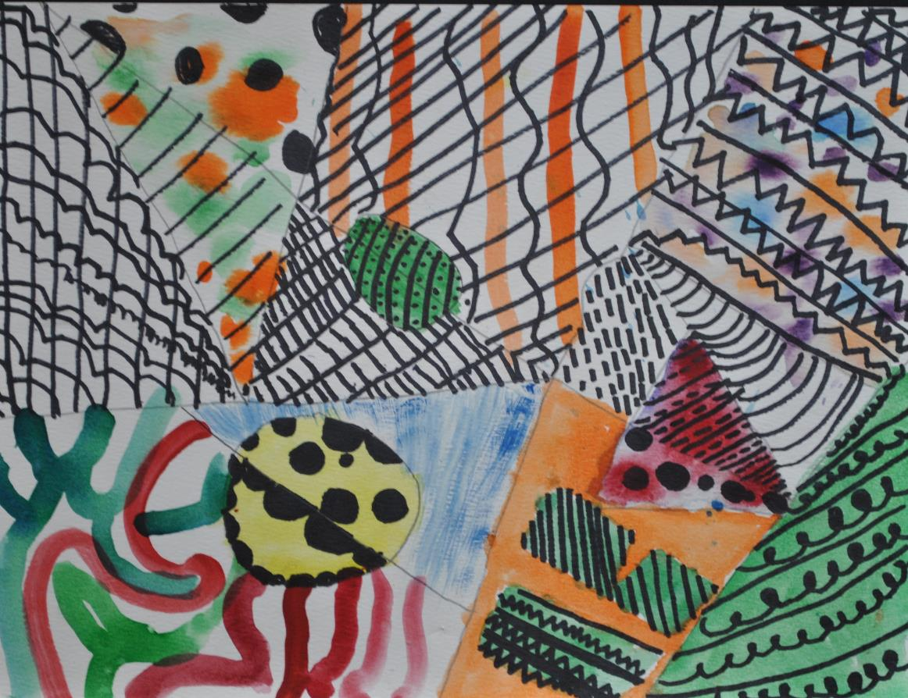

Slide 38
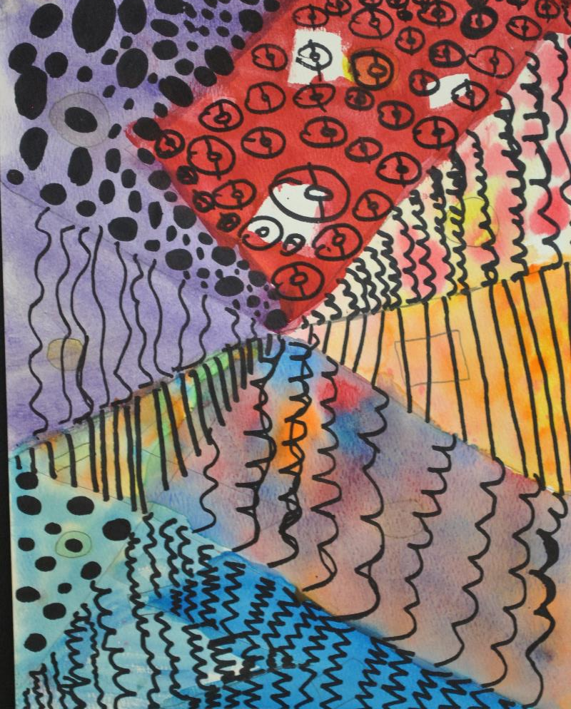

Slide 40
Garton Elementary
Dan Sickles
Art Educator
Brooke Meier 4th Grade
Destiny Calkins 4th Grade
Julius Cavan 1st Grade
Travis Johnson 3rd Grade
Maria Hernandez 5th Grade

Slide 46
Greenwood Elementary
Lori Bonz
Art Educator
Dajonna Lee 5th Grade
Clara Hol 5th Grade
Margaret Joyce 5th Grade
Samuel Krieg 4th Grade
Mya Salah 4th Grade
Jack Keenan 4th Grade
Gaius Herron 1st Grade
Eden Bearns 1st Grade
Mia Davila 3rd Grade
Leilani Simmons 5th Grade

Slide 51
Hanawalt Elementary
Kathryne Marek
Art Educator
Margo Green
Bell, Grace 2nd Grade
Holland, Veronica 1st Grade
Naumann, Ellie 5th Grade
Lorenzen, Emmett 3rd Grade

Slide 55
Hillis Elementary
Liz Bloomburg
Art Educator
Omer Aksamovic Kindergarten
Atbera Shamila 1st Grade
Mirnela Hasanagic 3rd Grade
Long Hoang 5th Grade
Ivan Hyde 3rd Grade
Gabriel Colocho-Orozco 4th Grade
Yadira Moreno-Ramirez 4th Grade
Kameryn Henrichs 4th Grade

